Slide 1
New Student (Online) Registration:
The parent's perspective

Slide 2
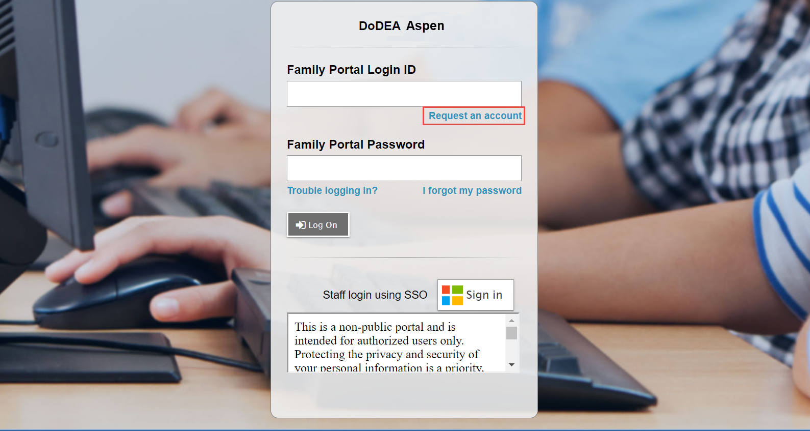
Family Portal View
Parents will access the portal at: https://dodeasis.myfollett.com/aspen
The parent needs an Aspen user account to log in to the application.
If they do not have an Aspen account yet, they click the Request an Account link.

Slide 3
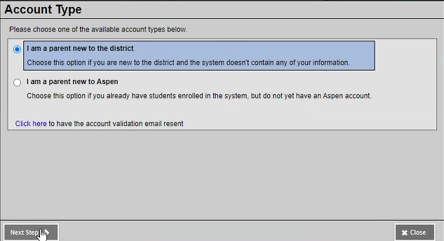
Requesting an Account
After clicking the link, the Account Type pop-up appears.
The parent clicks I am a parent new to the district, and then clicks Next.
Notes:
Facilitator notes: DoDEA is creating an automated process for activating Sponsor/Spouse accounts. Therefore, the second option will not apply to DoDEA families.

Slide 4
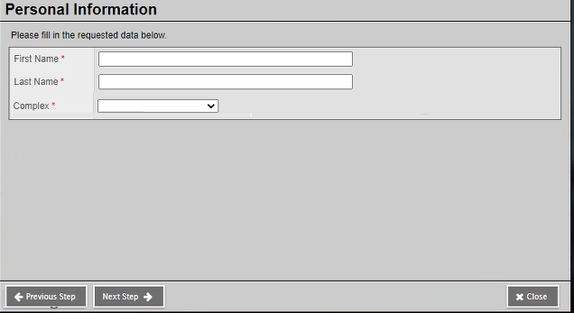
Requesting an Account (continued)
The parent enters their information, and then clicks Next Step.
Notes:
Facilitator notes: Complex = Installation

Slide 5
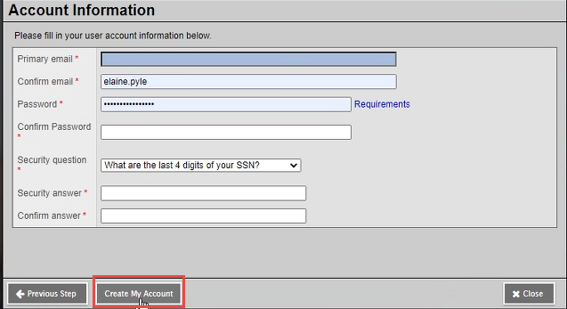
Requesting an Account (continued)
The parent enters additional contact information, creates a password, and selects/answers a security question.
The parent clicks Create My Account.
When the account is created, the parent is notified via email.

Slide 6
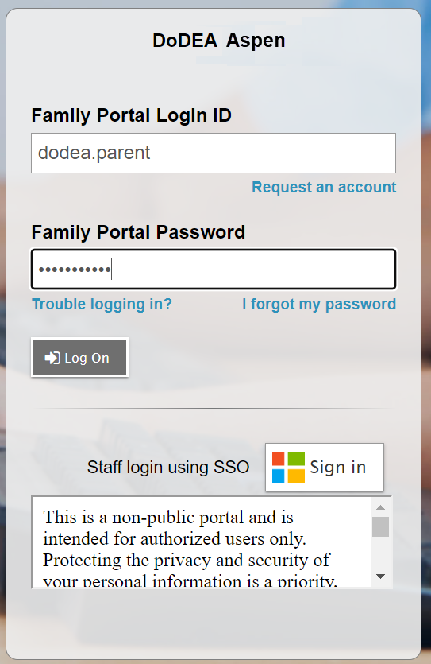
Logging in to the Parent Portal
Then, when the parent returns to the Login screen, they enter their credentials and click Log On.

Slide 7
Initial registration:
The parent's perspective

Slide 8
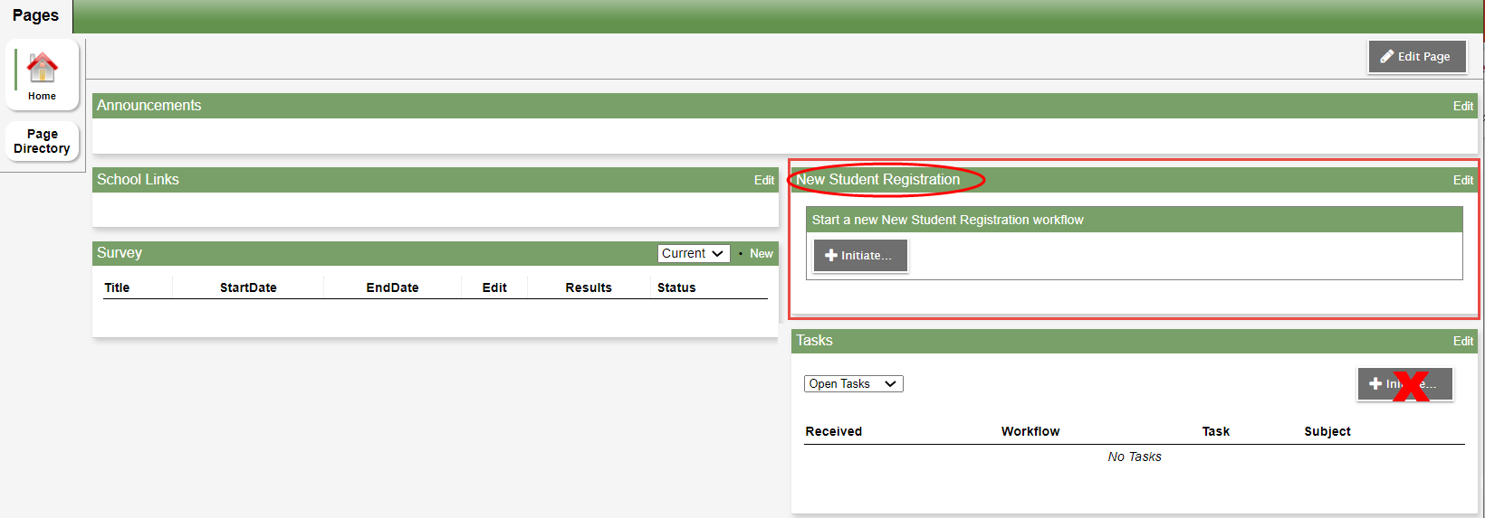
New Student Registration Widget
When the parent logs in to Aspen, they are brought to their homepage (the Pages tab).
To register a student, the parent locates the New Student Registration widget on the homepage, and then clicks the Initiate button.

Slide 9
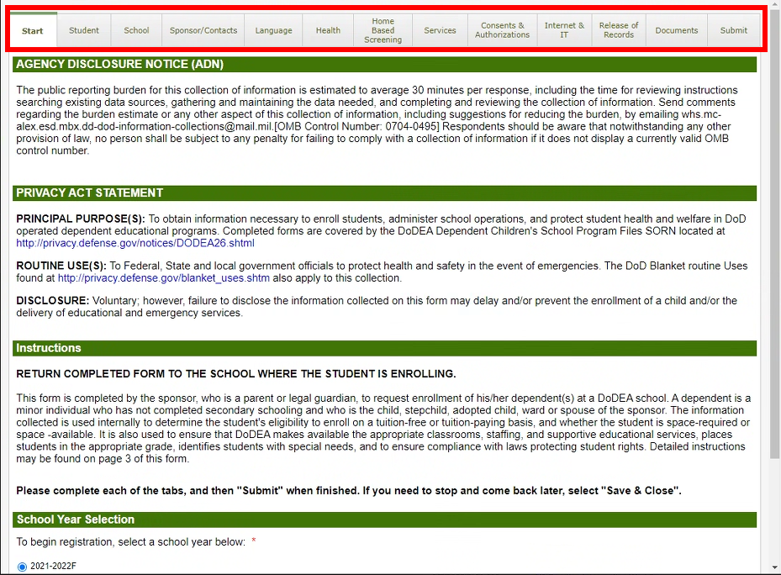
The Start Tab
The parent enters information on a series of tabs.
Start is the first tab. On this tab, the parent selects the school year they are registering their student for and other information. Some fields are required.
Notes:
Facilitator notes: Required fields in registration process are denoted with red asterisk.

Slide 10
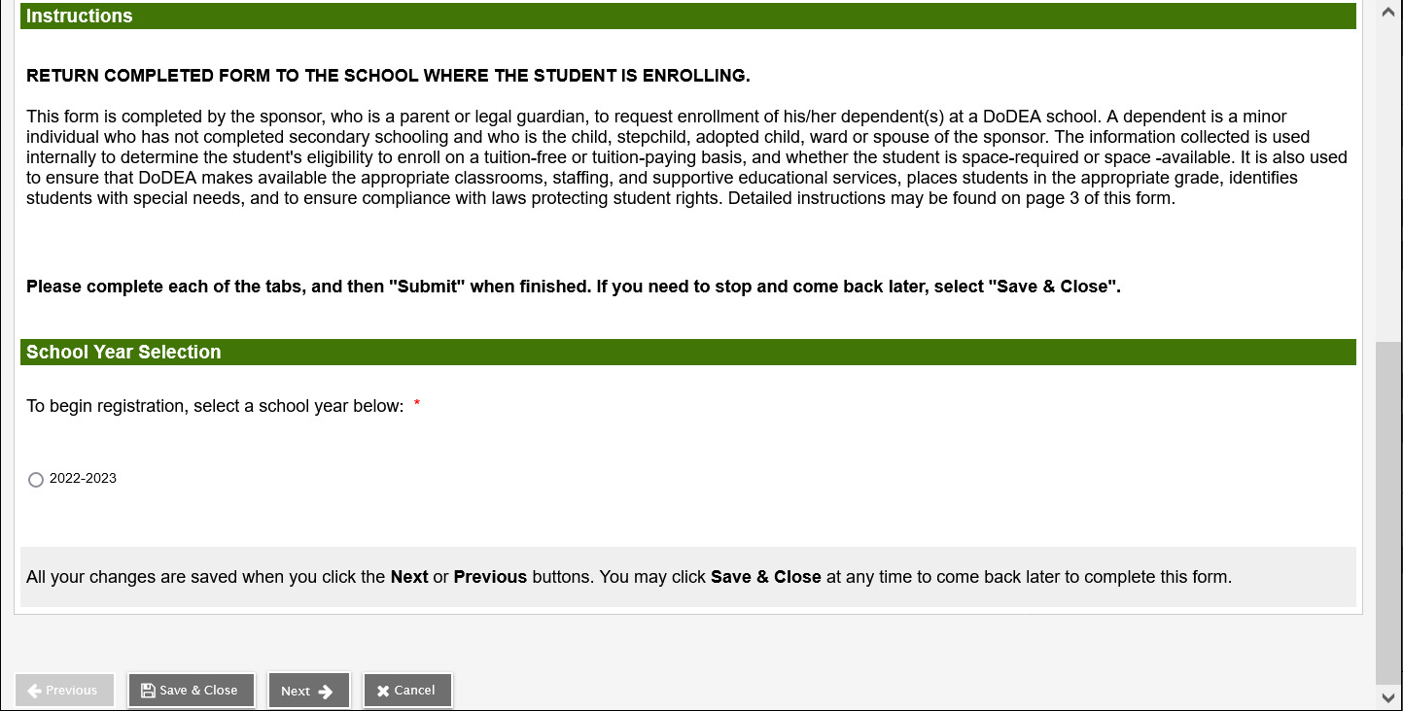
The Start Tab (continued)
If the parent needs to pause at any time and resume later, they can click Save & Close.
The parent clicks Next after each tab is complete.

Slide 11
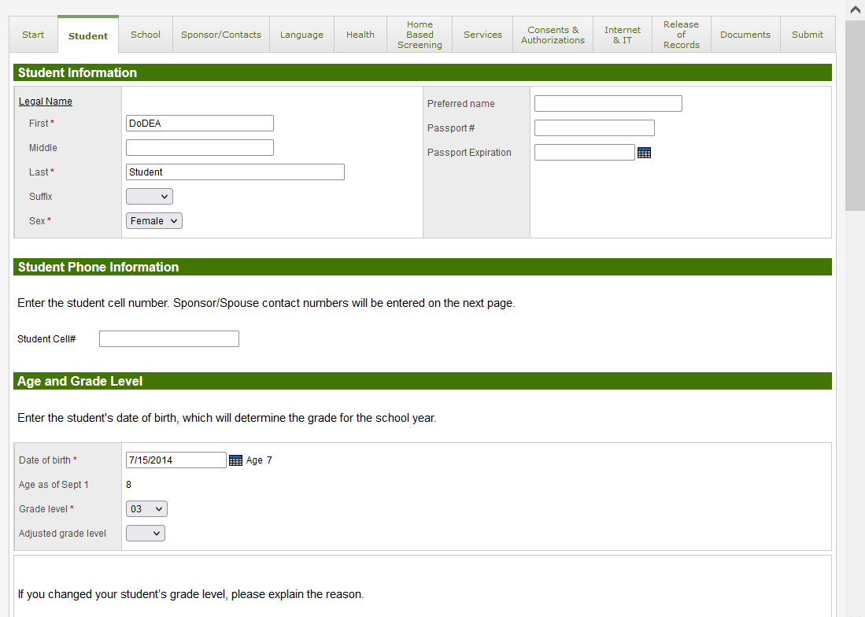
The Student Tab
The parent enters the child's name, date of birth, and other information on this tab.
Parent can change the grade level, if needed, and provide an explanation.

Slide 12
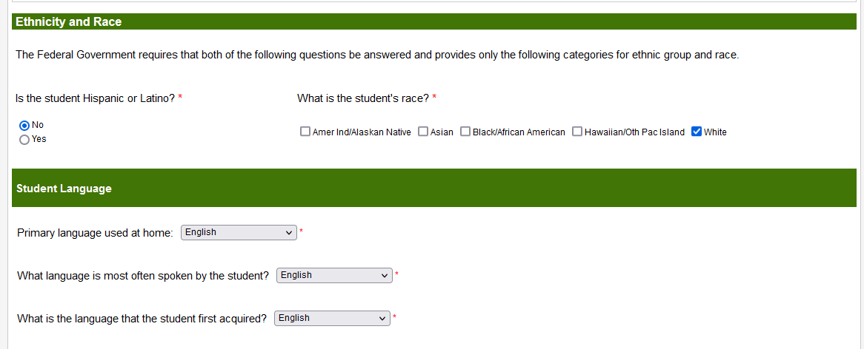
The Student Tab (continued)

Slide 13
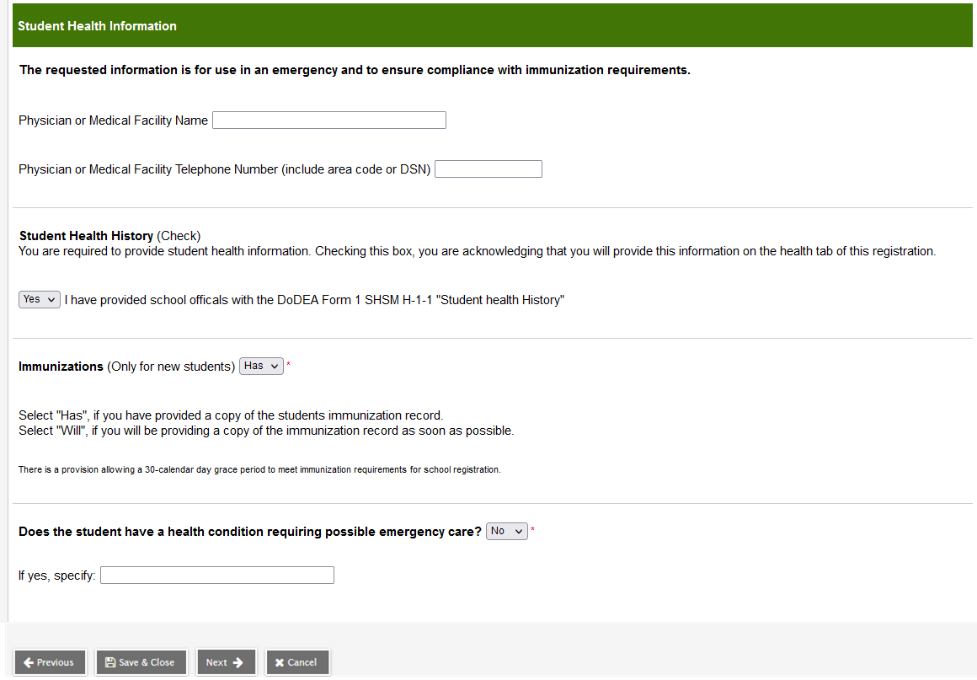
The Student Tab (continued)
The parent clicks Next to navigate to the next tab.

Slide 14
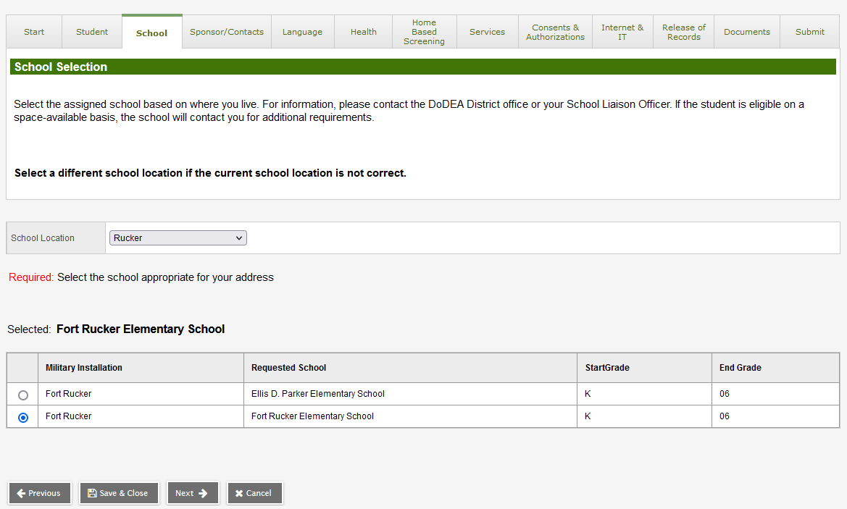
The School Tab
The parent selects the child's school based on where they live.
If the parent changes the school location, the school list changes.
The parent clicks Next to navigate to the next tab.

Slide 15
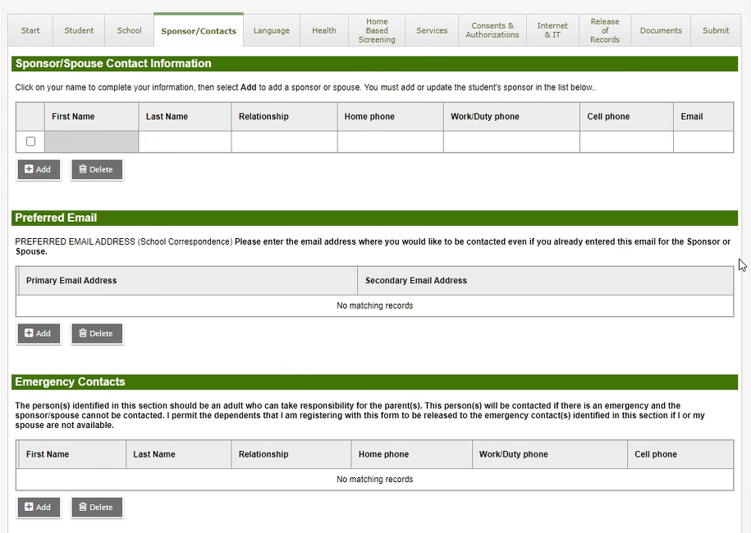
The Sponsor/Contacts Tab
On this tab, the parent clicks their name to complete their contact information.
The parent can enter information for a sponsor or spouse by clicking Add.

Slide 16
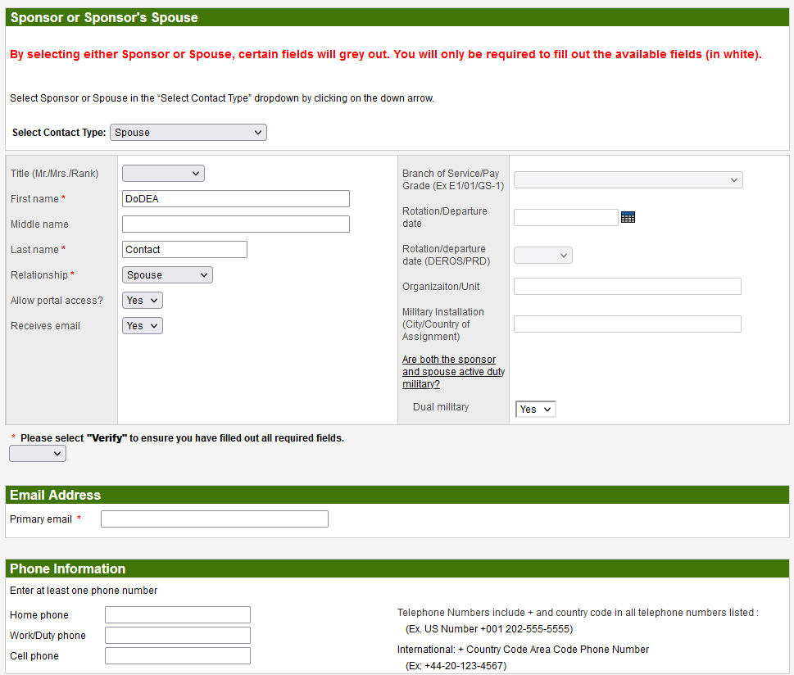
The Sponsor/Contacts Tab (continued)
The parent can enter information for a sponsor or spouse using the Select Contact Type drop-down.
After entering this information, they use the Verify drop-down to ensure they have completed all required fields.

Slide 17
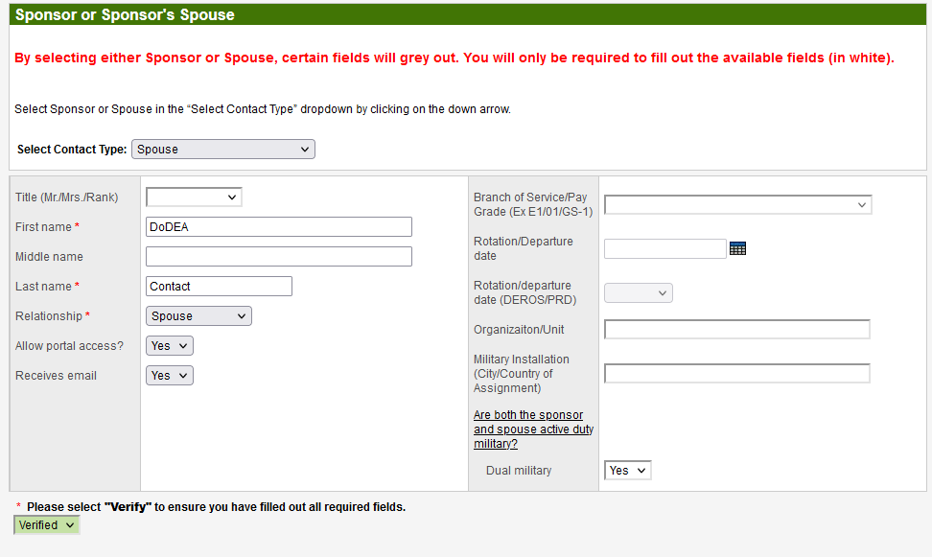
The Sponsor/Contacts Tab (continued)

Slide 18
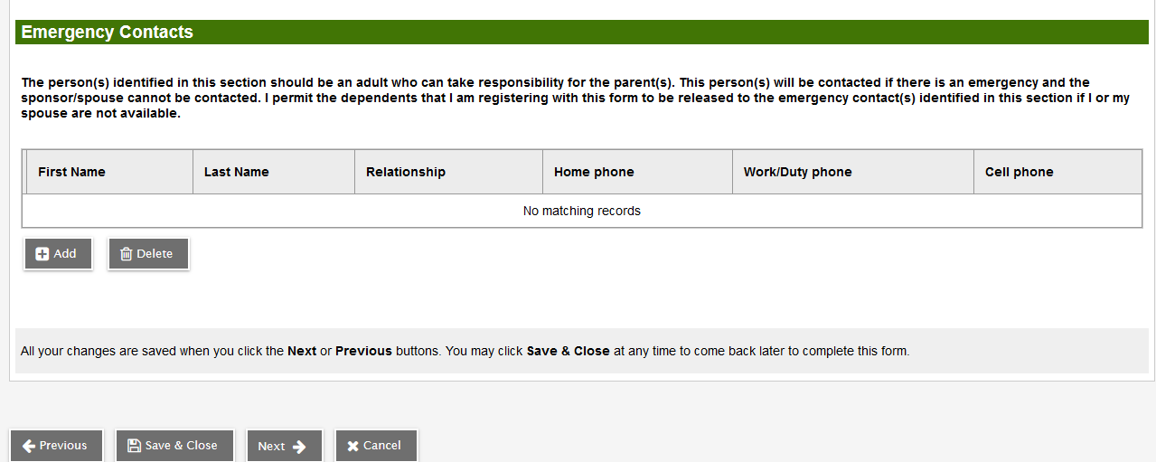
The Sponsor/Contacts Tab (continued)
Local/stateside emergency contacts are added in the bottom section of this tab.
Click Next to continue.

Slide 19
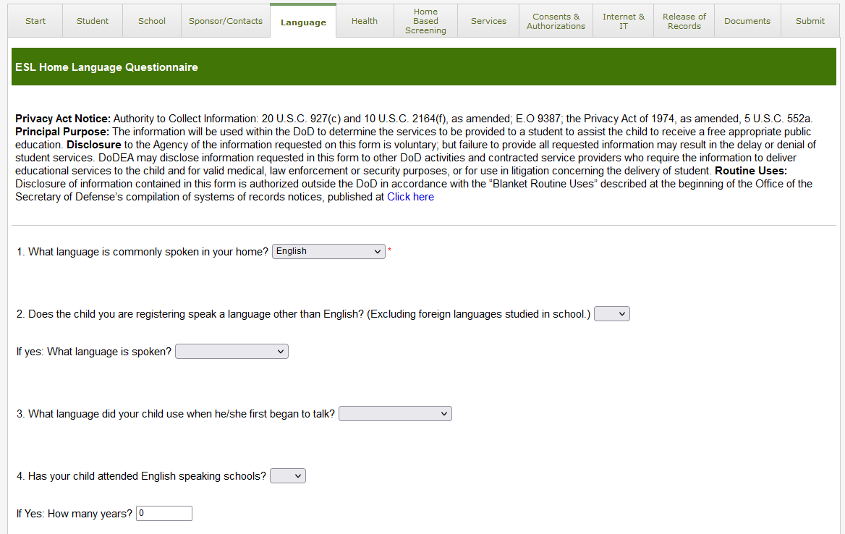
The Language Tab
The parent enters information about the child's home language.

Slide 20
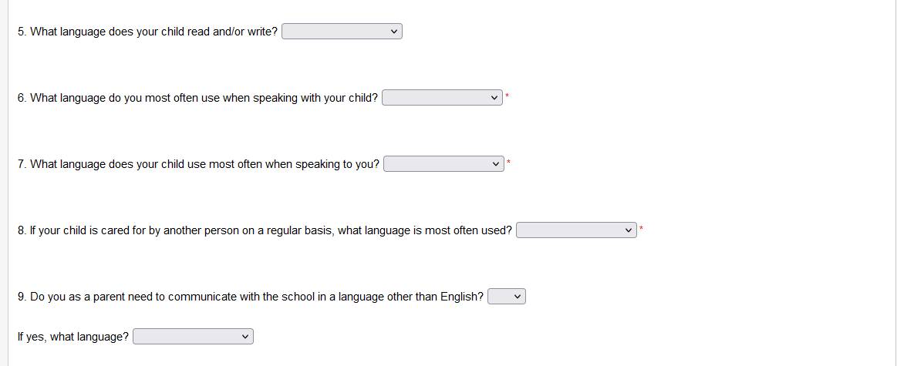
The Language Tab (continued)

Slide 21
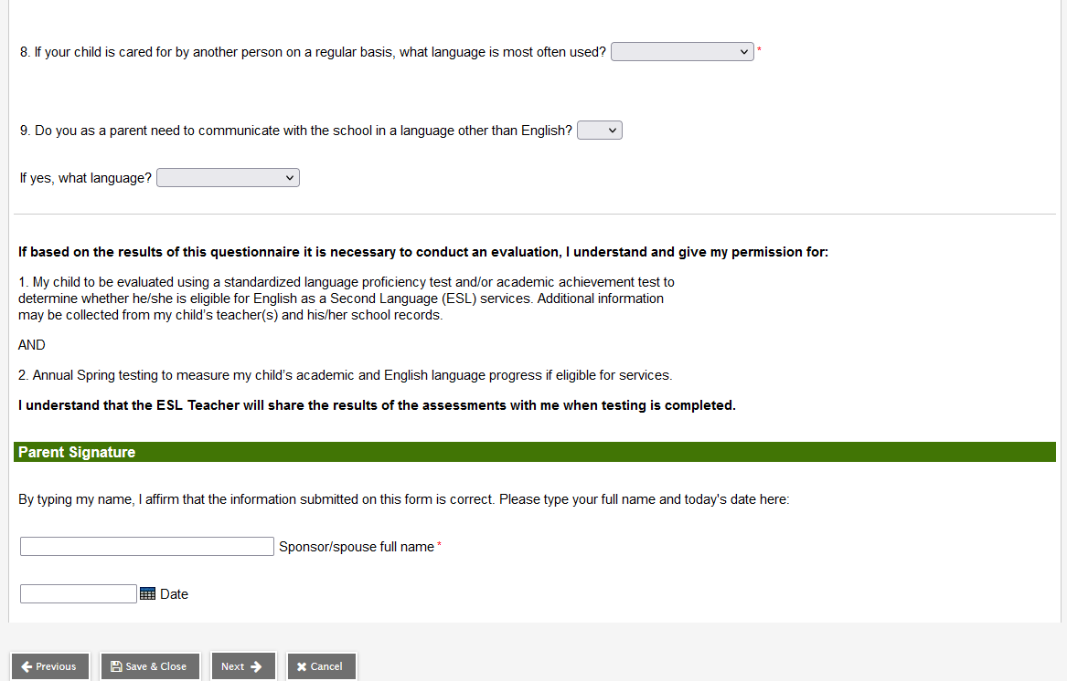
The Language Tab (continued)

Slide 22
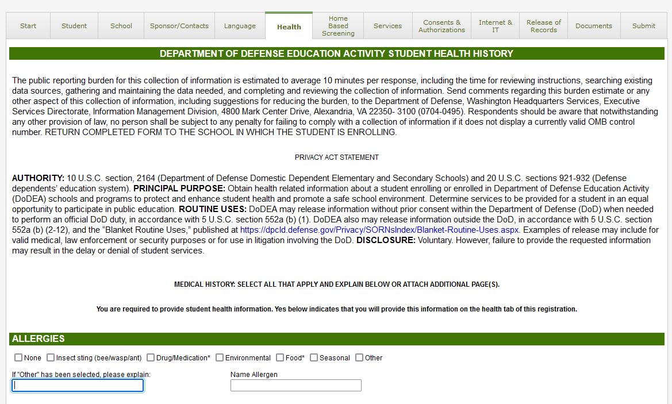
The Health Tab

Slide 23
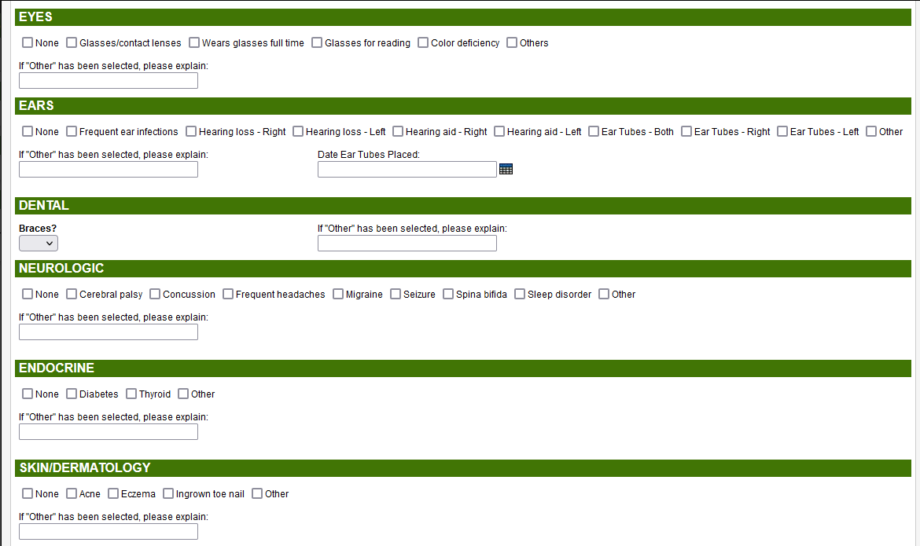
The Health Tab (continued)

Slide 24
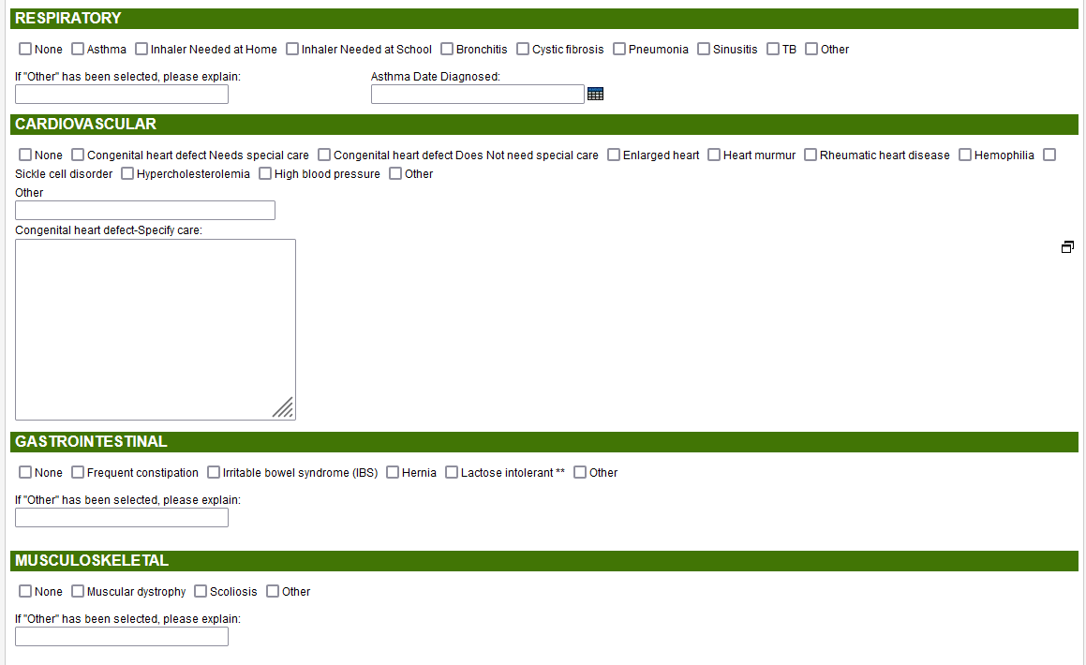
The Health Tab (continued)

Slide 25
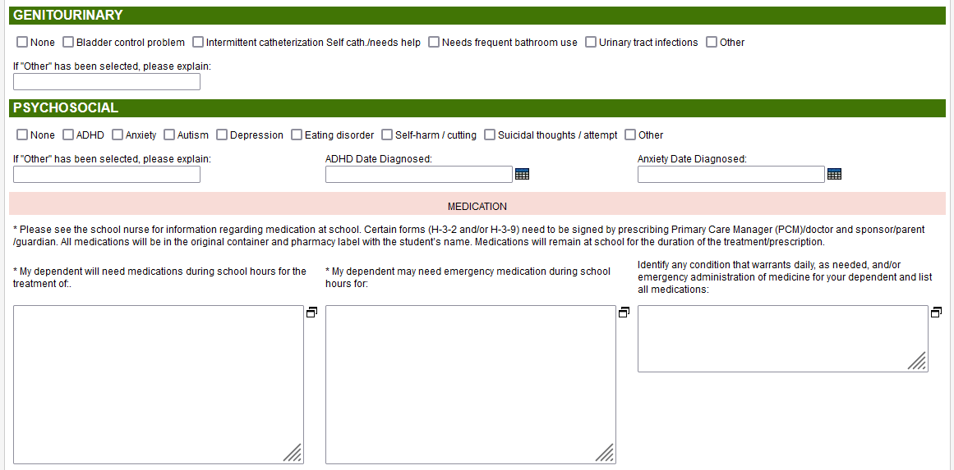
The Health Tab (continued)

Slide 26
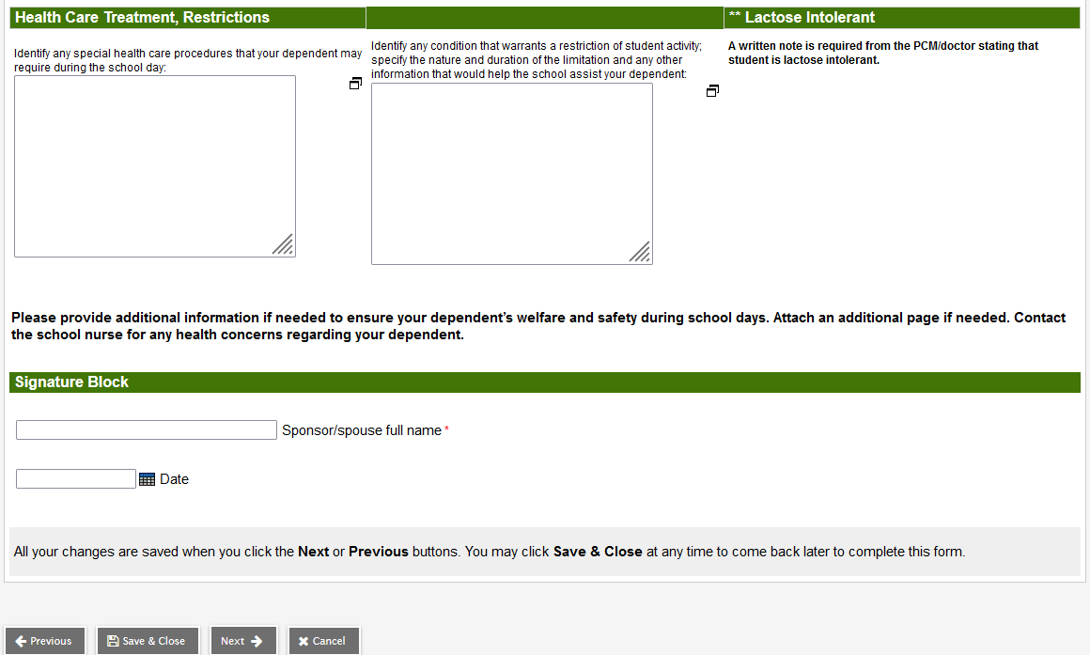
The Health Tab (continued)

Slide 27
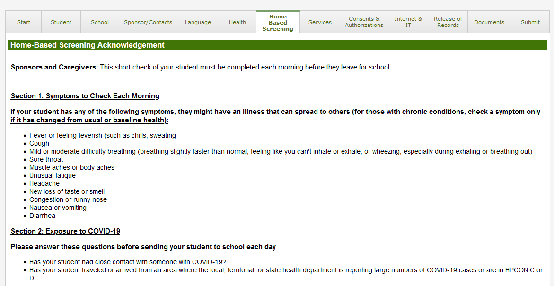
The Home-Based Screening Tab

Slide 28
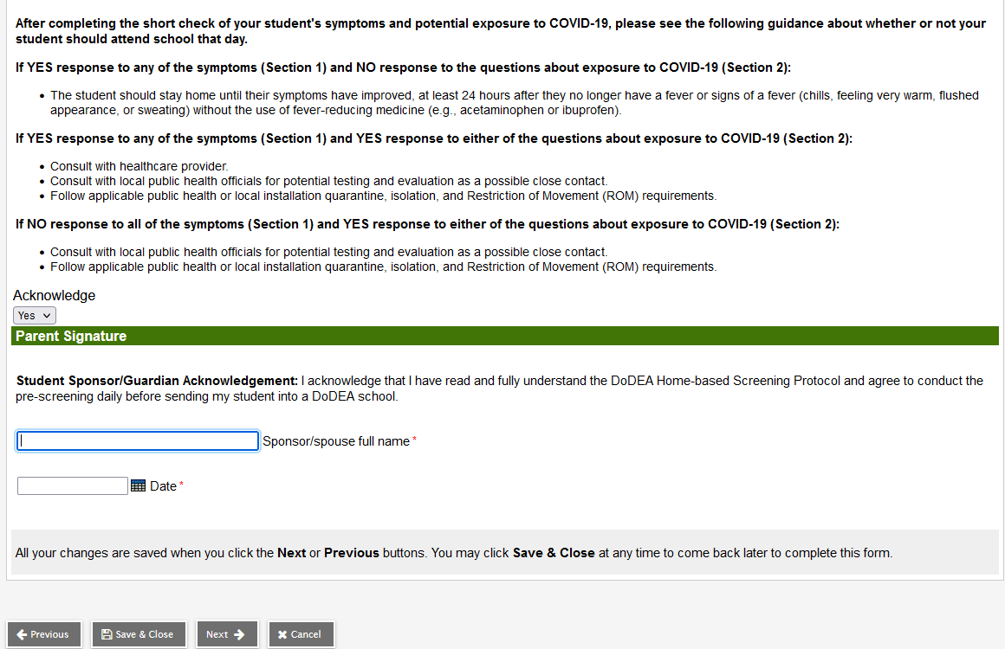
The Home-Based Screening Tab (continued)

Slide 29
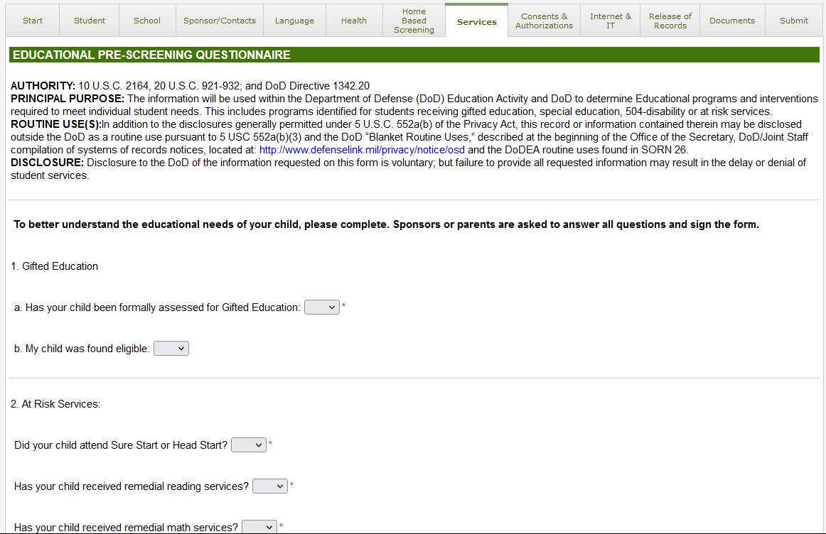
The Services Tab

Slide 30
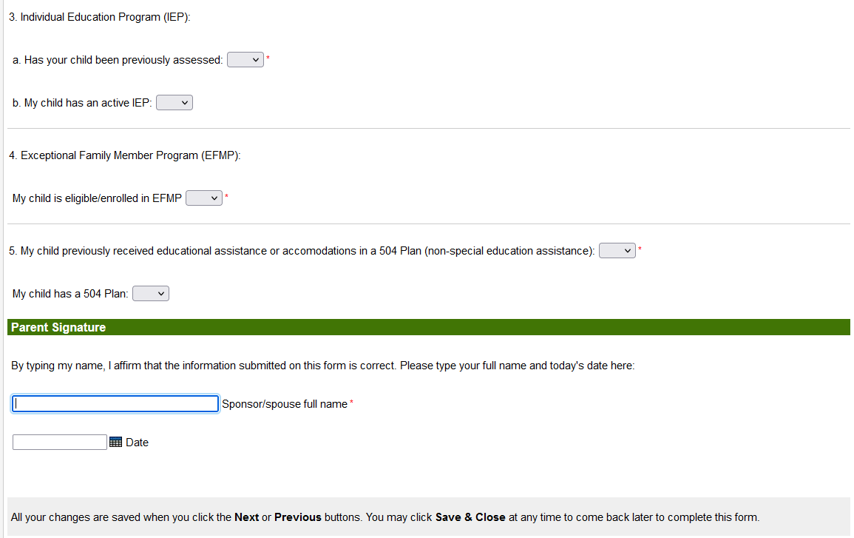
The Services Tab (continued)

Slide 31
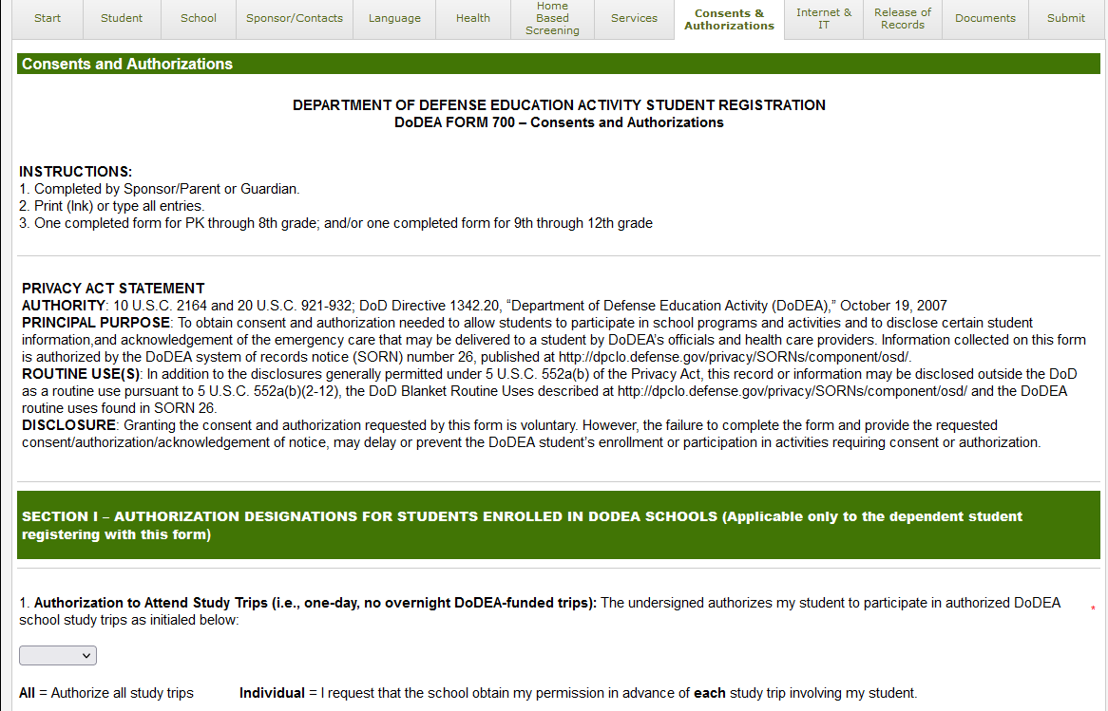
The Consent & Authorizations Tab

Slide 32
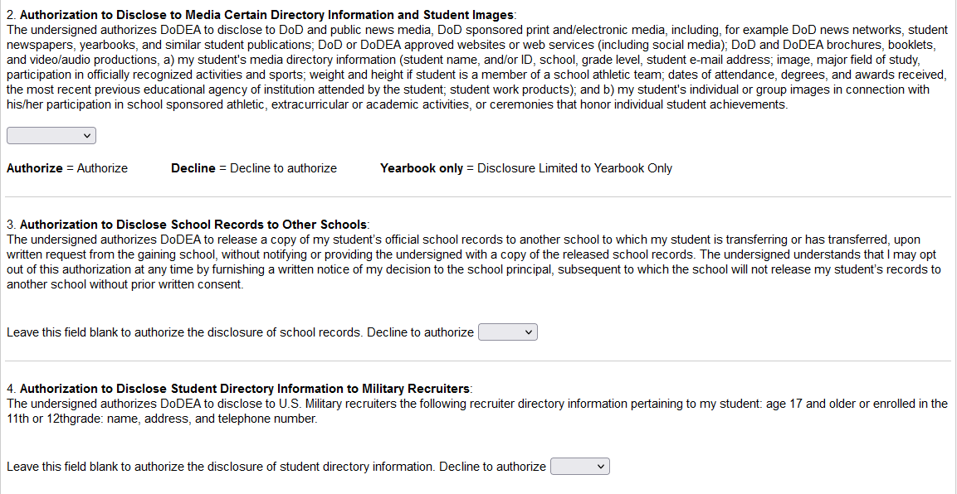
The Consent & Authorizations Tab (continued)

Slide 33
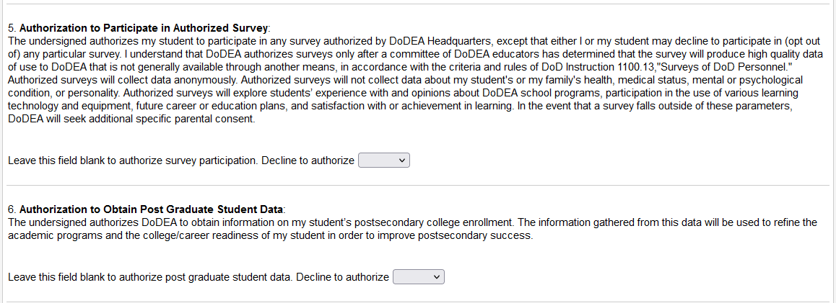
The Consent & Authorizations Tab (continued)

Slide 34
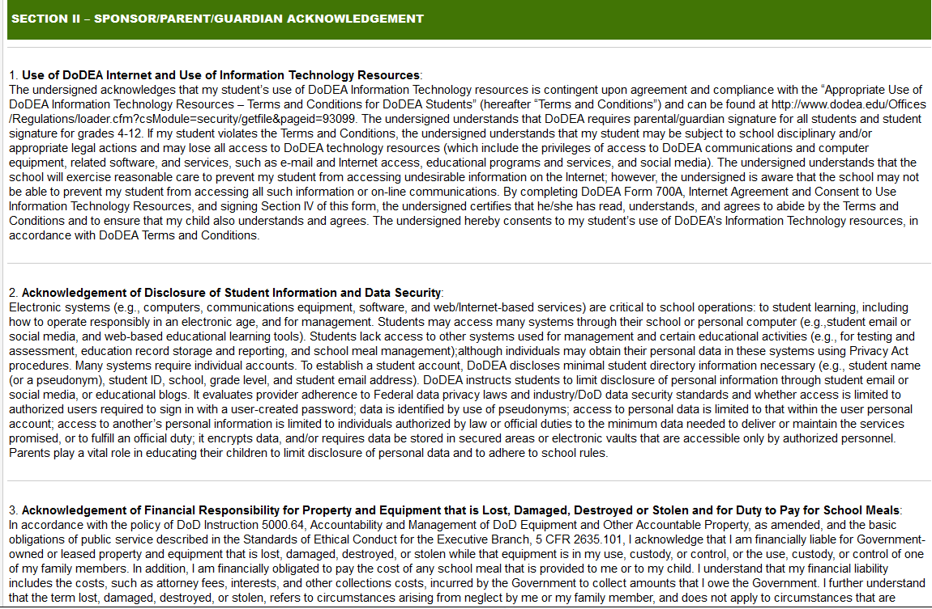
The Consent & Authorizations Tab (continued)

Slide 35
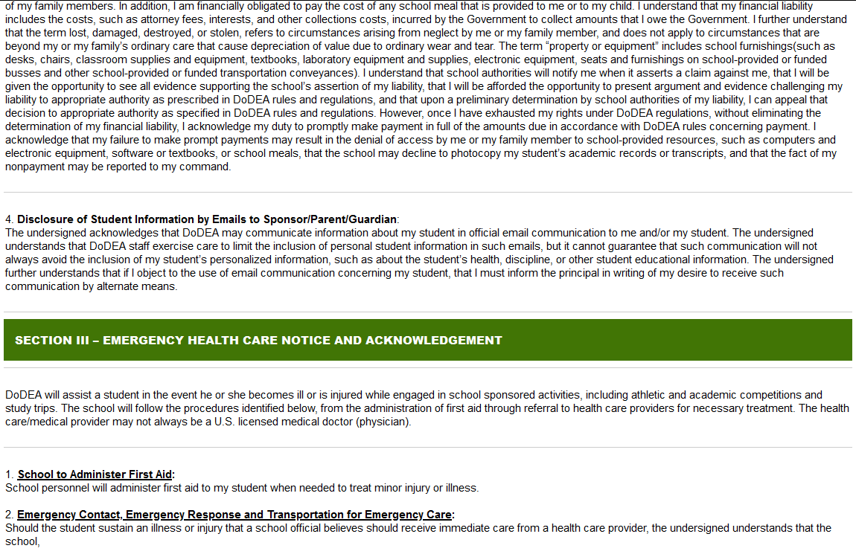
The Consent & Authorizations Tab (continued)

Slide 36
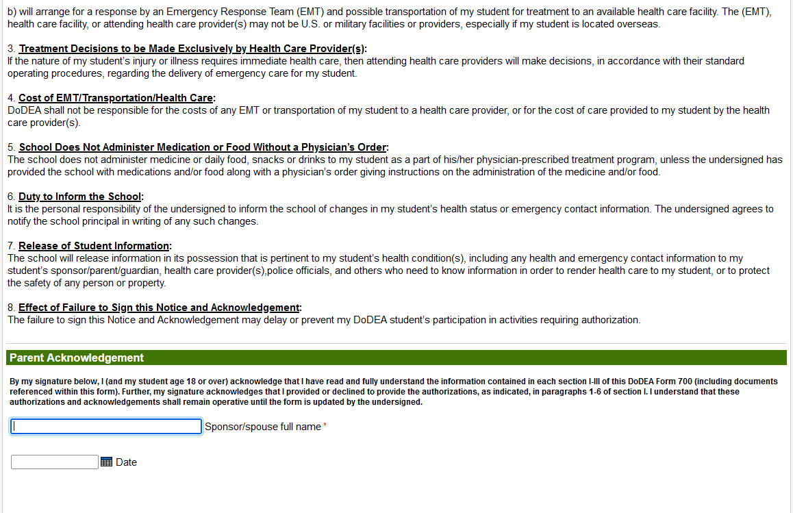
The Consent & Authorizations Tab (continued)

Slide 37
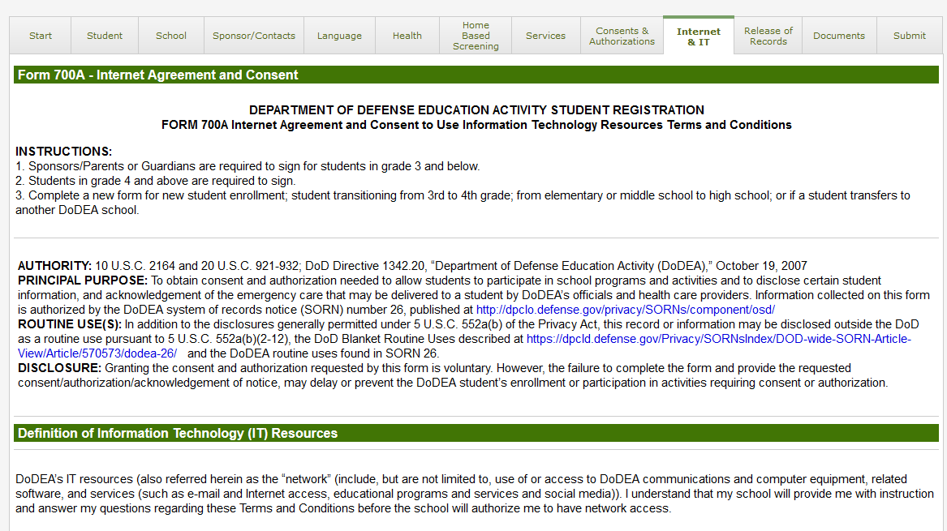
The Internet & IT Tab

Slide 38
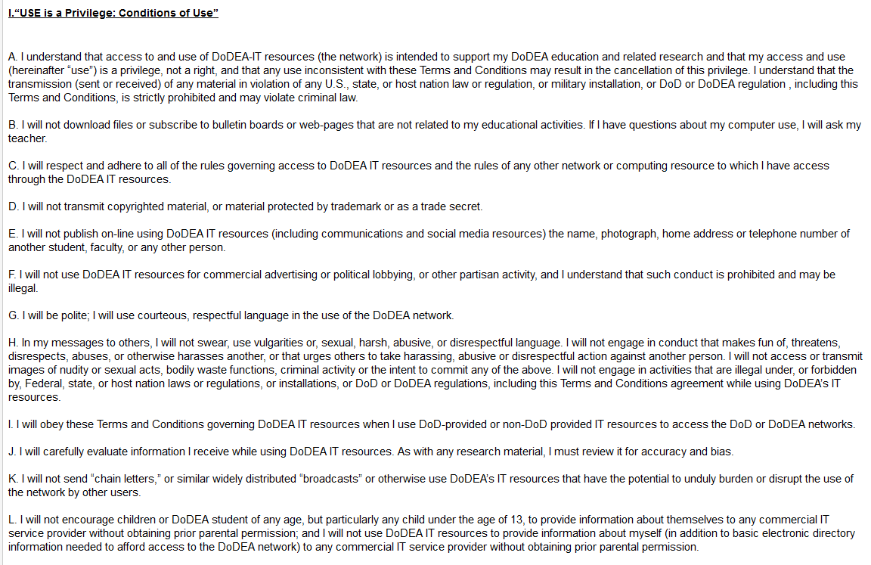
The Internet & IT Tab (continued)

Slide 39
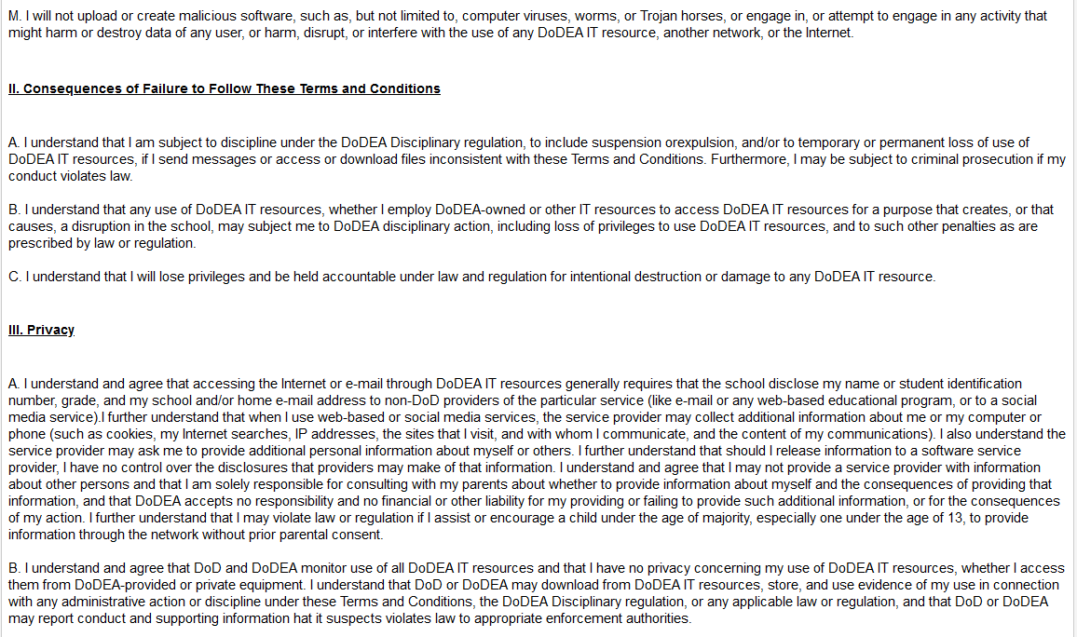
The Internet & IT Tab (continued)

Slide 40
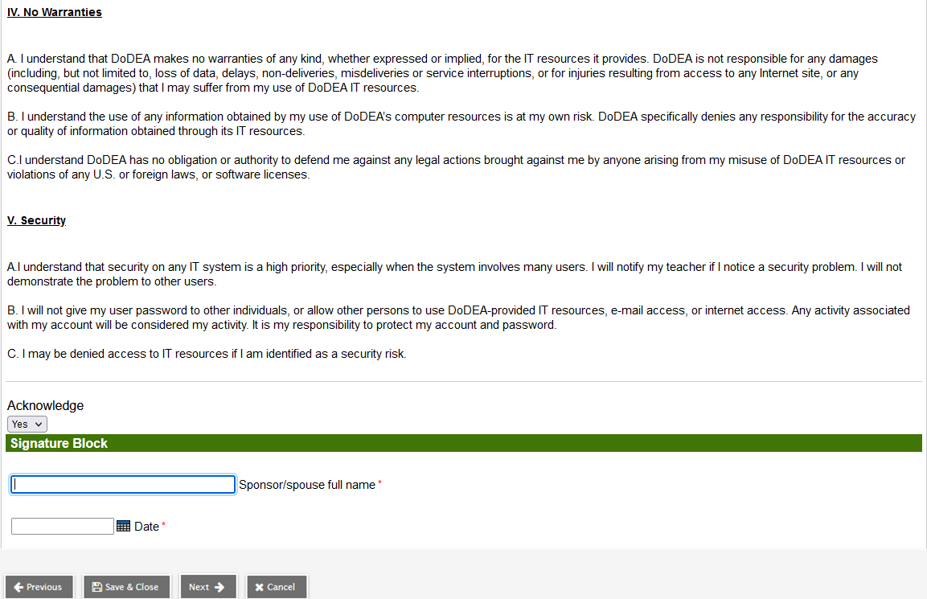
The Internet & IT Tab (continued)

Slide 41
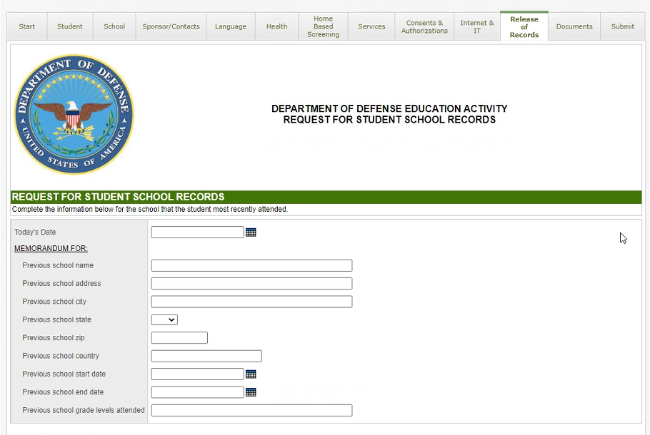
The Release of Records Tab
This is the Release of Records tab.
The parent enters information about the school the student most recently attended.

Slide 42
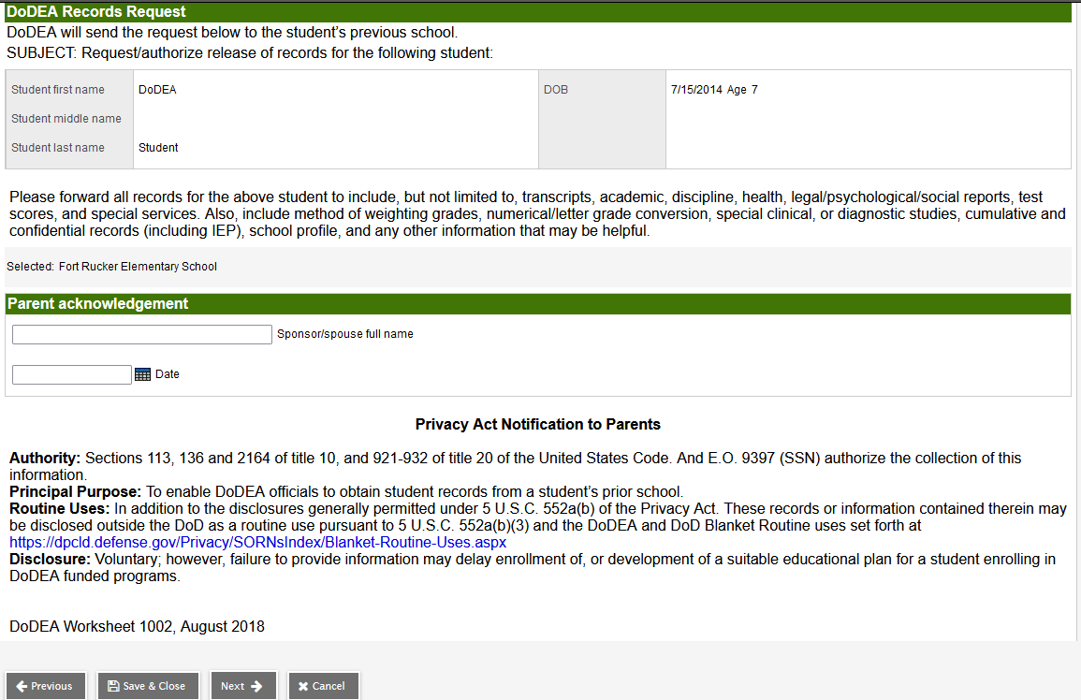
The Release of Records Tab (continued)
The form indicates the parent's consent for DoDEA to obtain the student's record from that school.

Slide 43
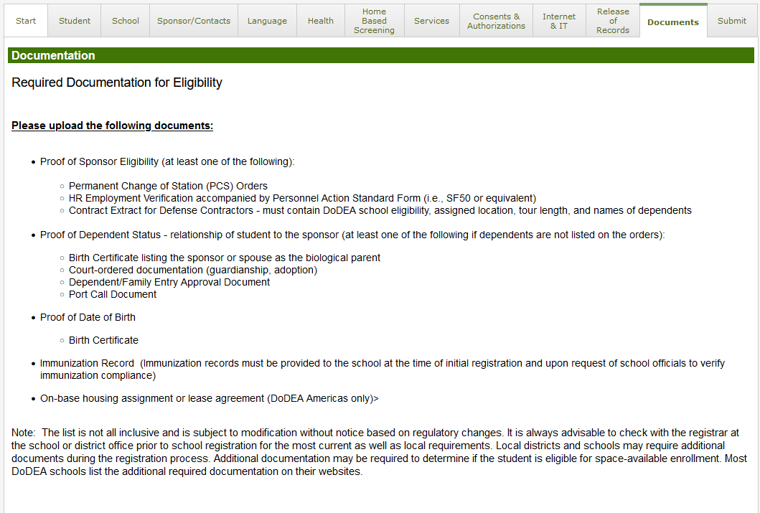
The Documents Tab
On the Documents tab, the parent uploads documents that indicate proof of:
Sponsor eligibility
Dependent status
Date of birth
Immunizations
On-base housing assignment or lease agreement

Slide 44
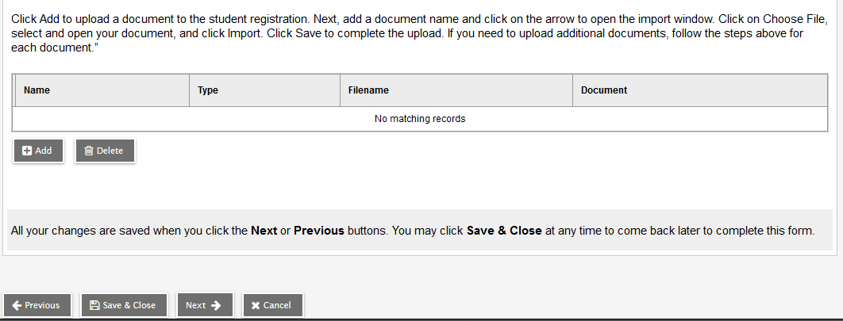
The Documents Tab (continued)
The parent clicks Add to upload a document, and then clicks the arrow to open the import window. Once they select the file, they click Import, then Save.
They click Next to move to the next tab.

Slide 45
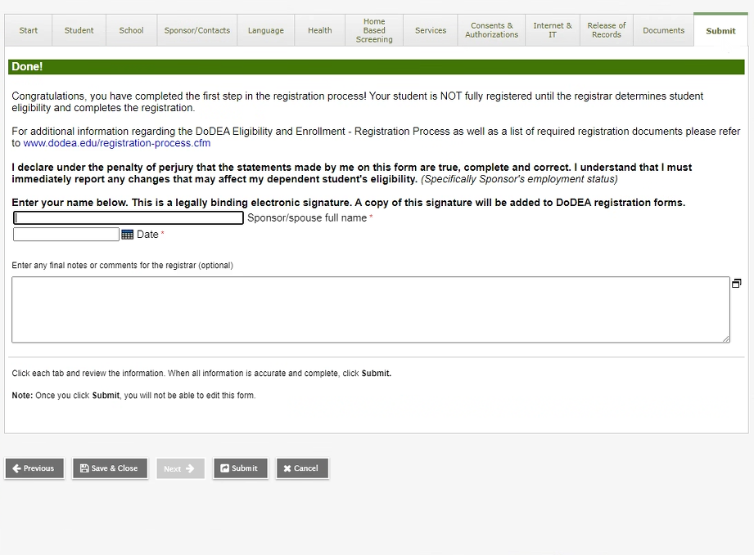
The Submit Tab
Submit is the final tab. The parent has entered their student's information and is ready to submit it for review.
The parent enters their signature and the date.
The parent can enter any additional information in the free-text field for the registrar to review.
When finished, the parent clicks Submit. The registrar can now review the registration in the School view.

